Slide 1


JavaScript Basics
String Array Methods
Map, set

Slide 2
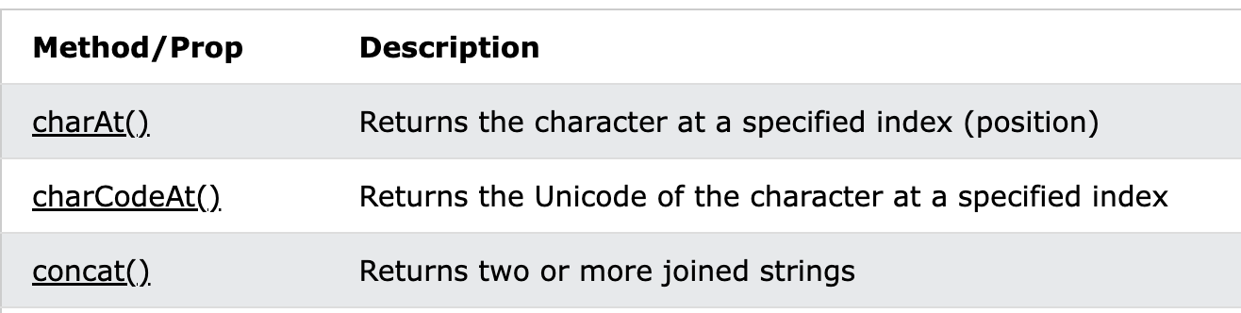
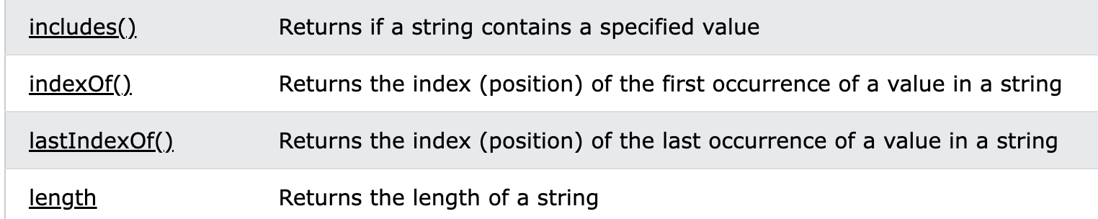
String Methods

Slide 3
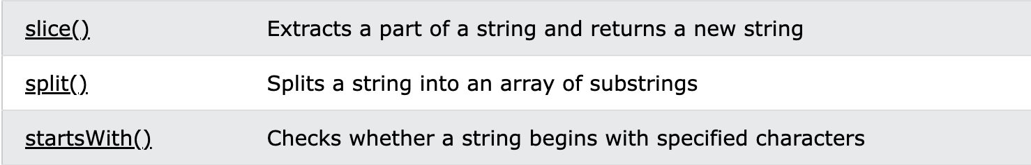
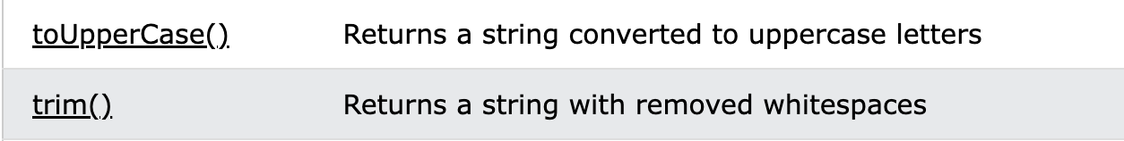
String Methods

Slide 4
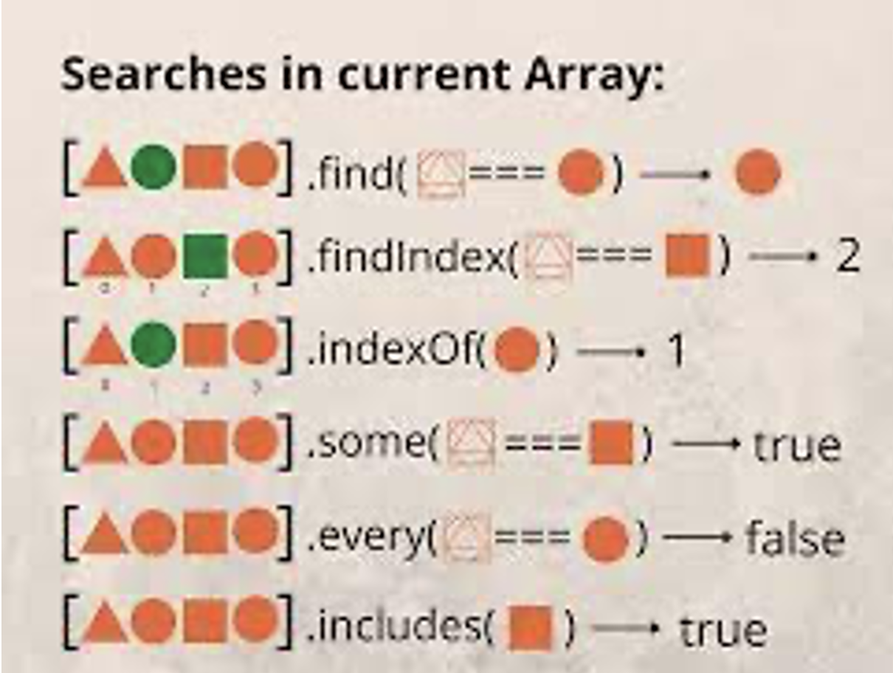
Array Methods

Slide 5
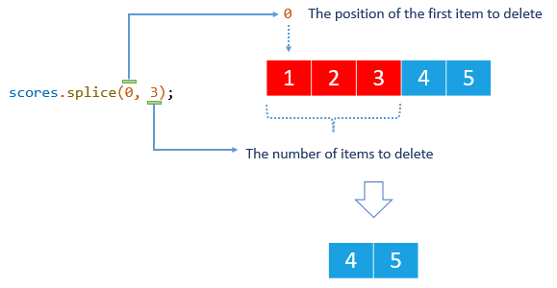

Slide 6
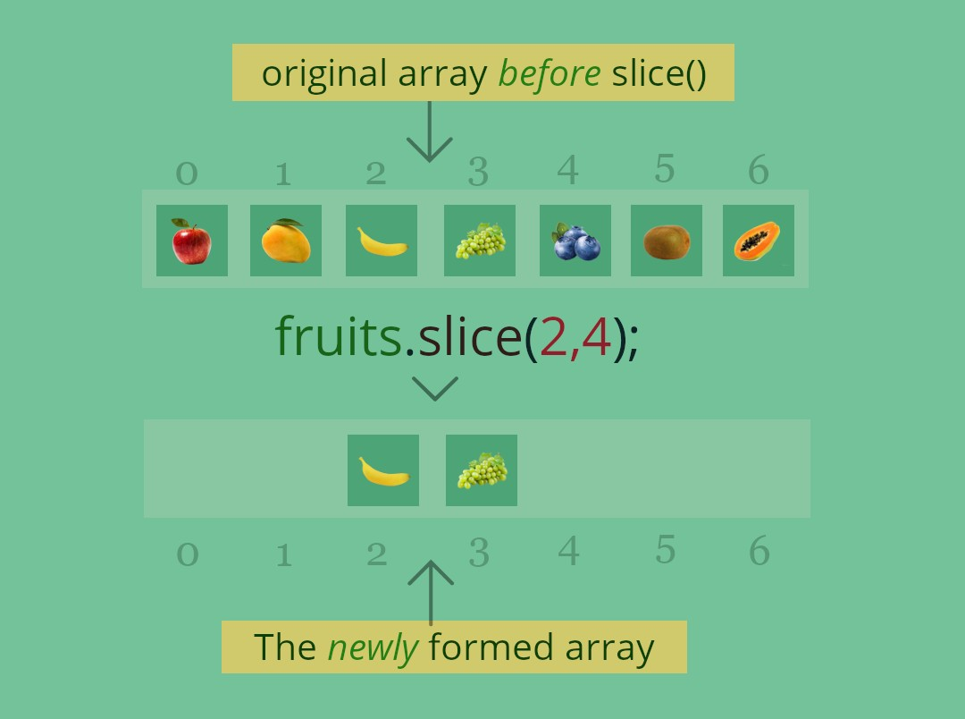
Slice

Slide 7
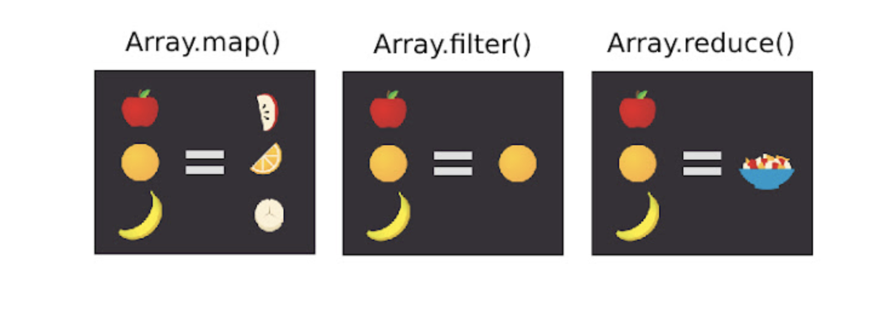
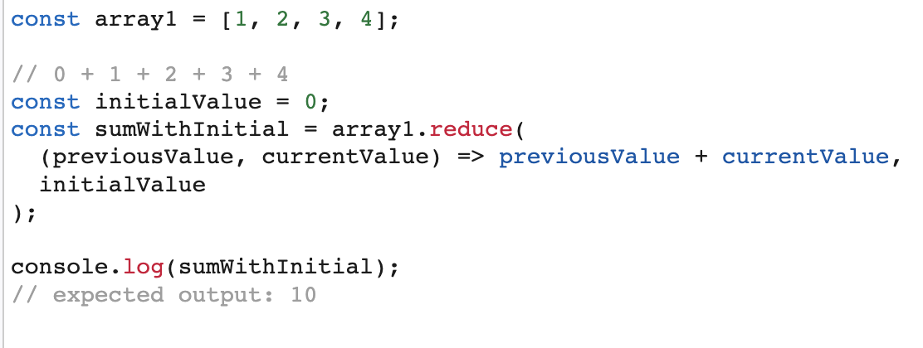
Reduce
Reduce

Slide 8
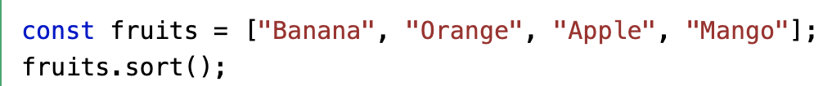
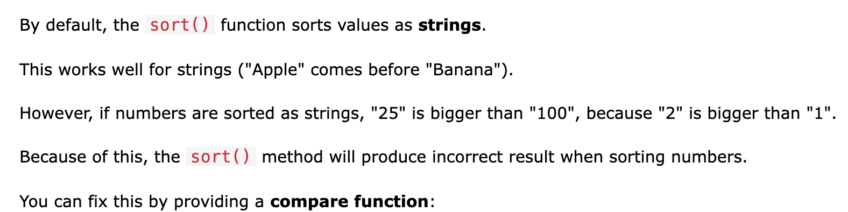
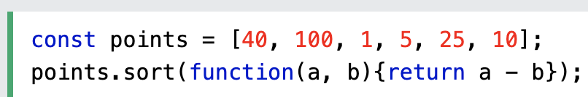
Sort

Slide 9
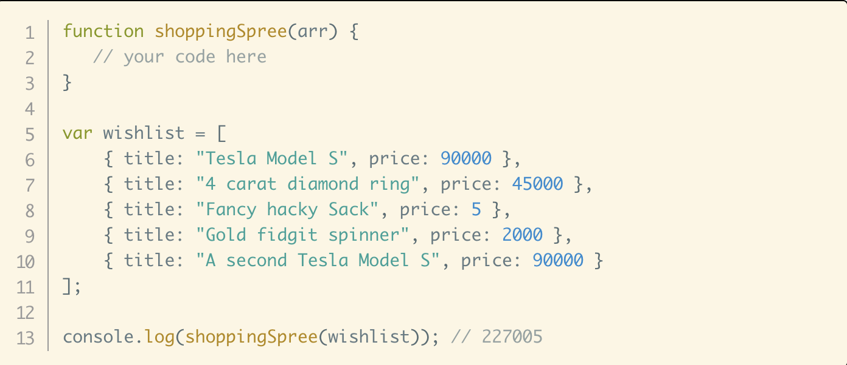
Tasks
1. Implement string.includes()
Given array of strings. Create new array using `.filter()` which includes only strings which starts with “aa”;
Given array of numbers. Create a new array which every element is equal old array element * 2;
Create a function which return true if all elements in array are same.
.

Slide 10
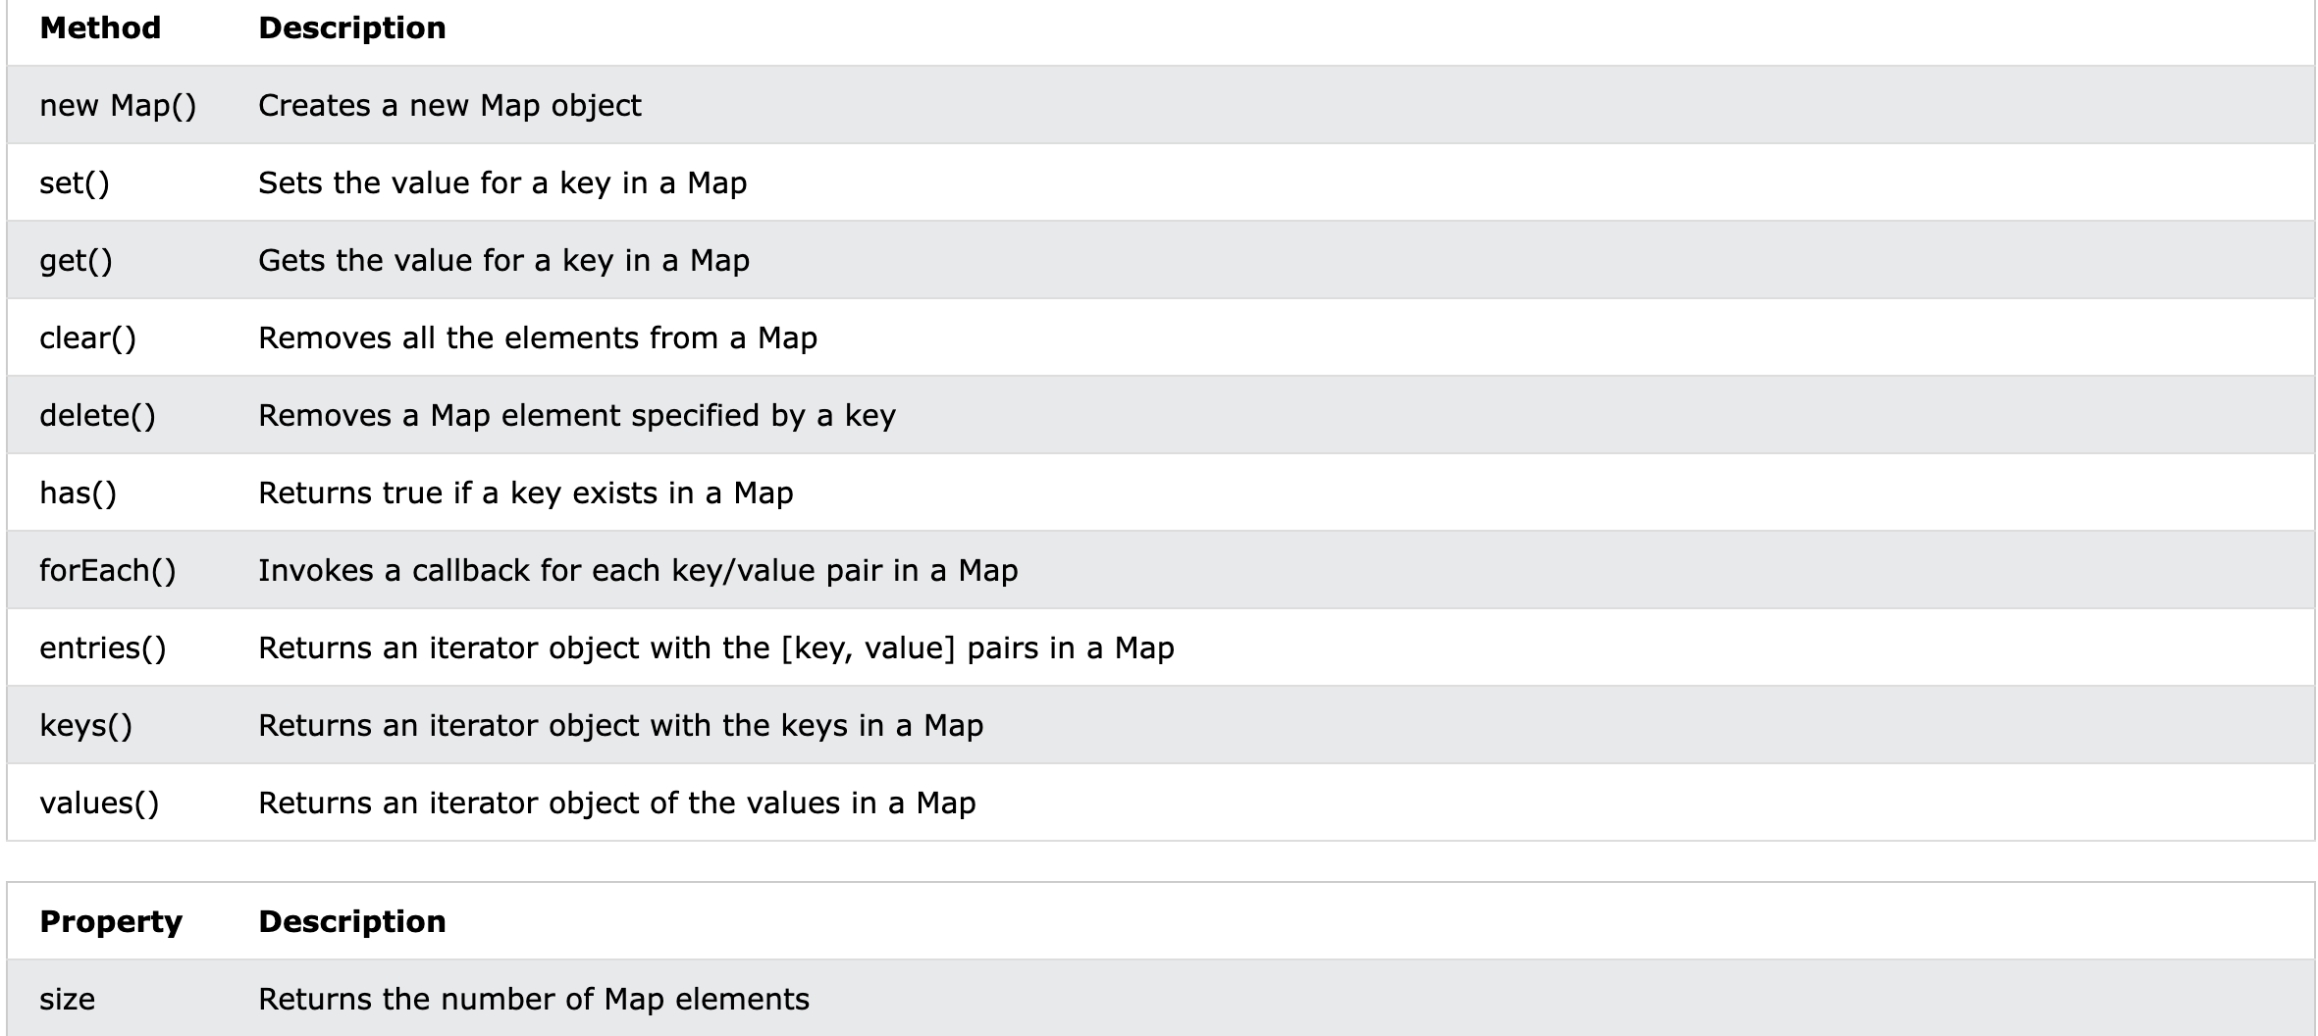
Map

Slide 11
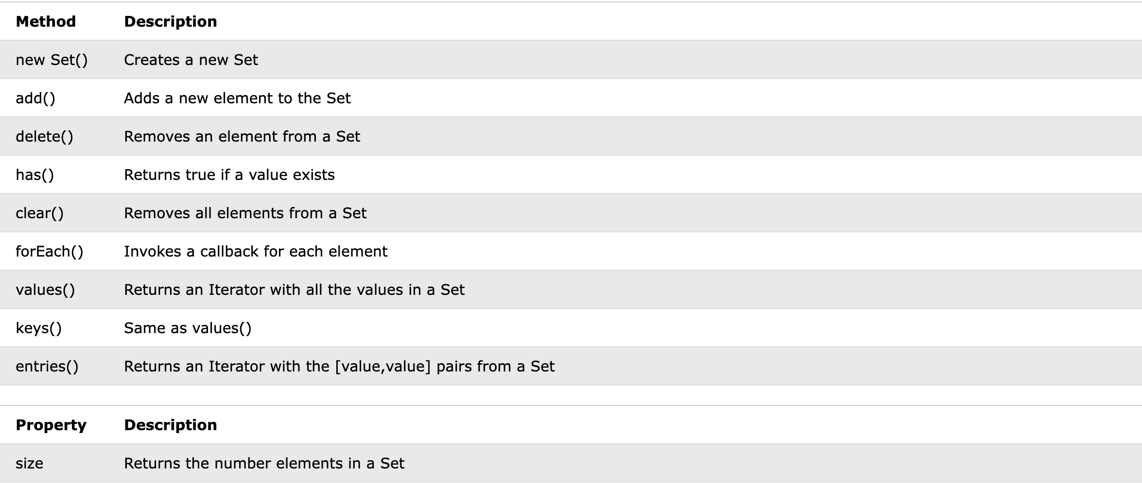
Set

Slide 12
Tasks
Creata a Dictionary class
1.1 Dictionarry must have has(key) set(key, value) remove(key) get(key) clear() size() keys() values().
2. Implement same Dictionary using Map();

